Slide 1
MoVid SaaS Application
Video Link
Pranav Addipalli
482561915

Slide 2
Business Problem
MoVid, a video management and streaming company is looking to move their in-house application to a cloud architecture.
The company is looking for a SaaS (Software as a Service) implementation
Must use 4-server architecture for different services:
Application Server
Wowza Streaming Engine
Video Transcoder
Microsoft SQL Database

Slide 3
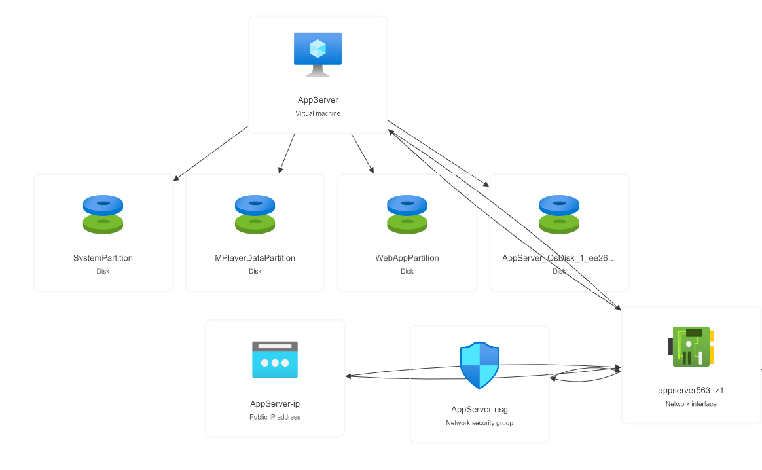
Proposed Architecture
Application Server

Slide 4
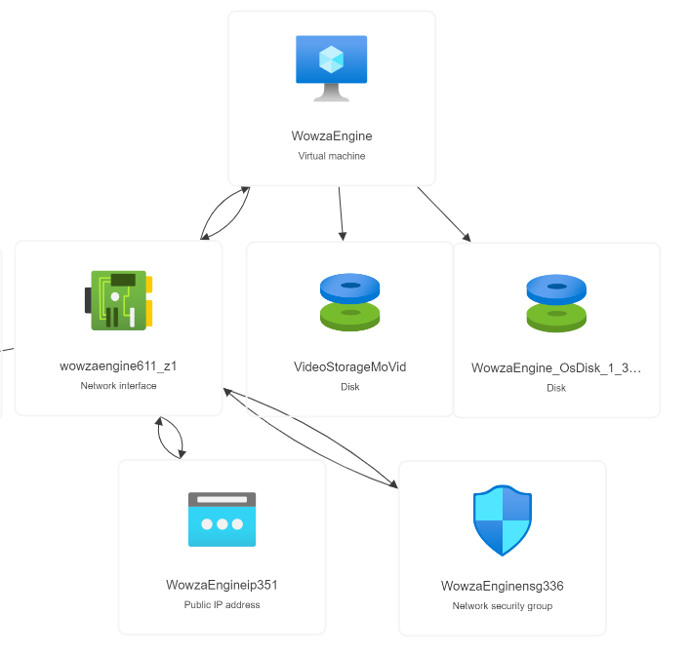
Proposed Architecture
Wowza Streaming Engine

Slide 5
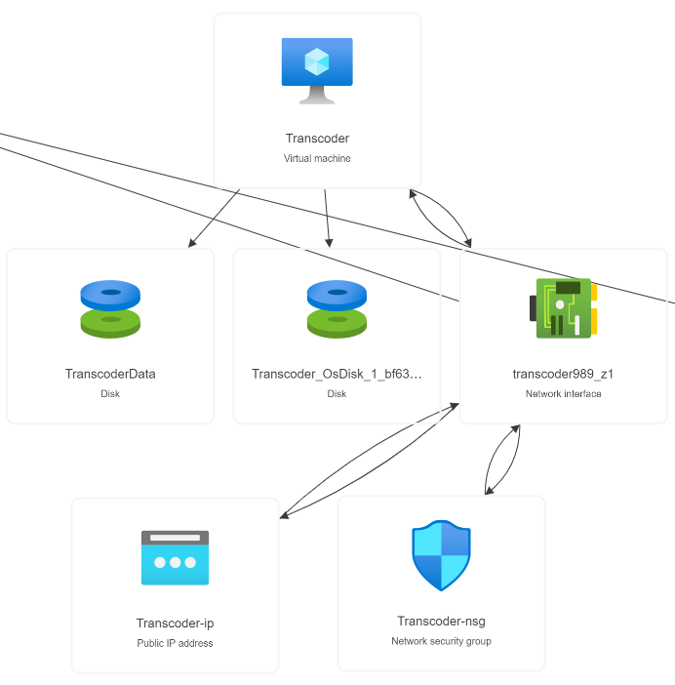
Proposed Architecture
Video Transcoder

Slide 6
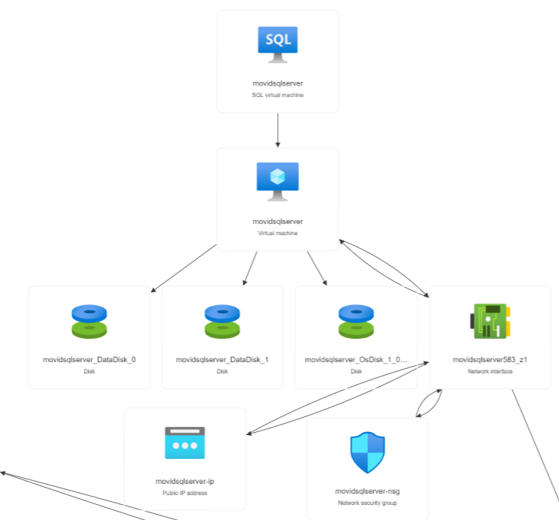
Proposed Architecture
MS SQL Server

Slide 7
Backup Methodologies
Backup methodologies is a very important aspect of a cloud infrastructure to ensure the data can be restored as part of disaster recovery management.
Video Backup for 60 days
SQL Backup for 30 days

Slide 8
Total Cost of Ownership
The TCO for different servers for 1 year is:
Application Server: 11000
Wowza Streaming Engine: 14000
Video Transcoder: 16000
MS SQL Server: 10000
Total Cost: $51000

Slide 9
Advanced Cloud
Azure SCUTIO is the best advanced cloud feature for MoVid:
It has extremely large storage capabilities
1000 times lower latency and greater endurance
Ideal for Applications with lots of data and transactional workloads

Slide 10
Thank You!
Pranav Addipalli
482561915

